Slide 1
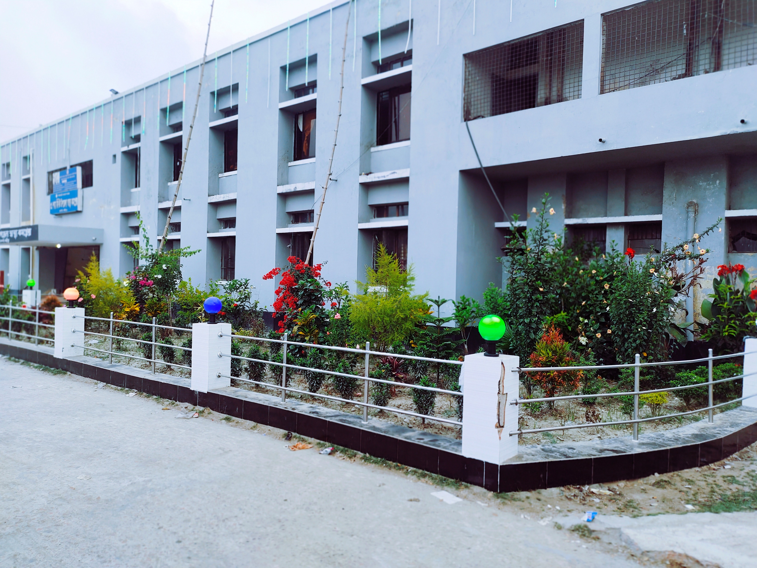
Upazila Health Complex
Welcome To
Ramgati Lakshmipur
31 Bed Hospital, Char Alexandar

Slide 2
A Hospital with a Vision …
Maximum utilization of Govt.
resources with
honesty and sincerity.
Integrated approach of
Administration, Community
Leaders .
Providing Effective services
through improved
management system.

Slide 3
Health Profile of Ramgati Upazila- 2022
Total Union: 07
Pouroshova: 01
Total Population: 2,30,000
Total Fertile Couple
Total Pregnant Mother
Total Under 5 Children
Health Human Resource
Doctor : 8
Nurse: 9
Midwives:2
Medical Technologist: 2
HA: 28
FWA- 26
CHCP- 18
Security Guard & Cleaner: 4
Health Institutions
Health Complex: 01
Sub-Centre:2,
FWC: 5
Community Clinic: 20
Non- Govt Clinic: -

Slide 4
Mother Taken-ANC 1st visit :
Mother taken ANC 4th Visit :
Hospital Delivery Rate :
No. of Hospital bed : 31
Bed Occupancy Rate :
EPI Coverage :
Covid-19 ( Immunization Coverage ):
CPR :
TFR :
CBR :
CDR :
Population Growth Rate :
Maternal Mortality Ratio :
Neonatal Mortality Rate :
Infant Mortality Rate :
Under-5 Mortality Rate :

Slide 5
Background History of Ramgati UHC
Ramgati UHC started as 20 bedded Hospital in ……
The Health complex upgraded to 31 bedded in….
From ……….. UH&FPO started …… special activates
<3 Special activities> (as example)
1) ANC-Corner
2)Basic EOC service
3)IMCI corner for Under 5 children
C-Section starts on ……
SSK Program starts on August 2022.

Slide 6

Ramgati UHC
Bed Occupancy Rate from 2017 to 2022
Please add data of Ramgati UHC

Slide 7
Emergency & Out Door, Indoor Service 2017 to July-2022
Ramgati UHC
Please add data of Ramgati UHC

Slide 8
Ramgati UHC
EOC Activities : 2017 to July 2022 (NVD and C-section)
Please add data of Ramgati UHC

Slide 9
Ramgati UHC
ANC Care: 2017 to July 2022 (ANC 1st and 4th Visit)
Please add data of Ramgati UHC

Slide 10
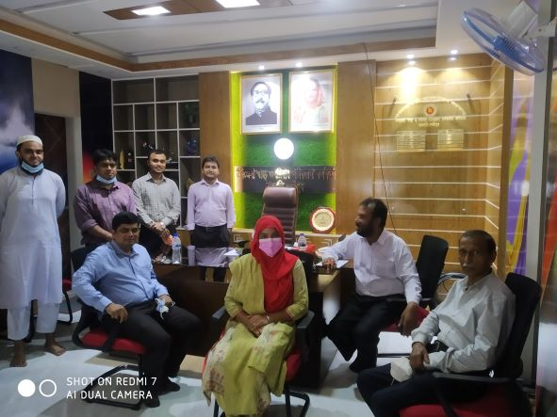
Office room of UH&FPO, Ramgati

Slide 11
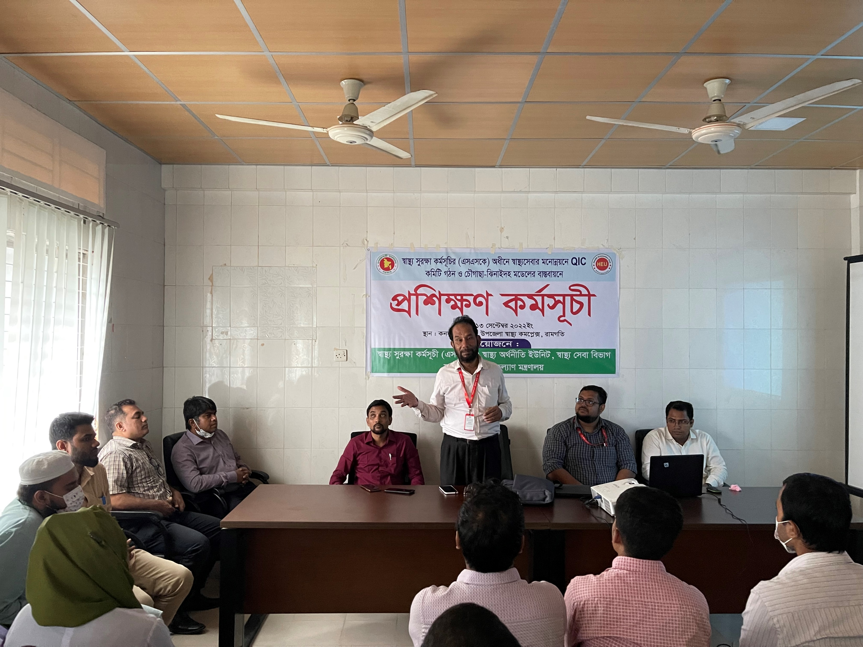
Training on Quality of Care and formation of QIC committee

Slide 12
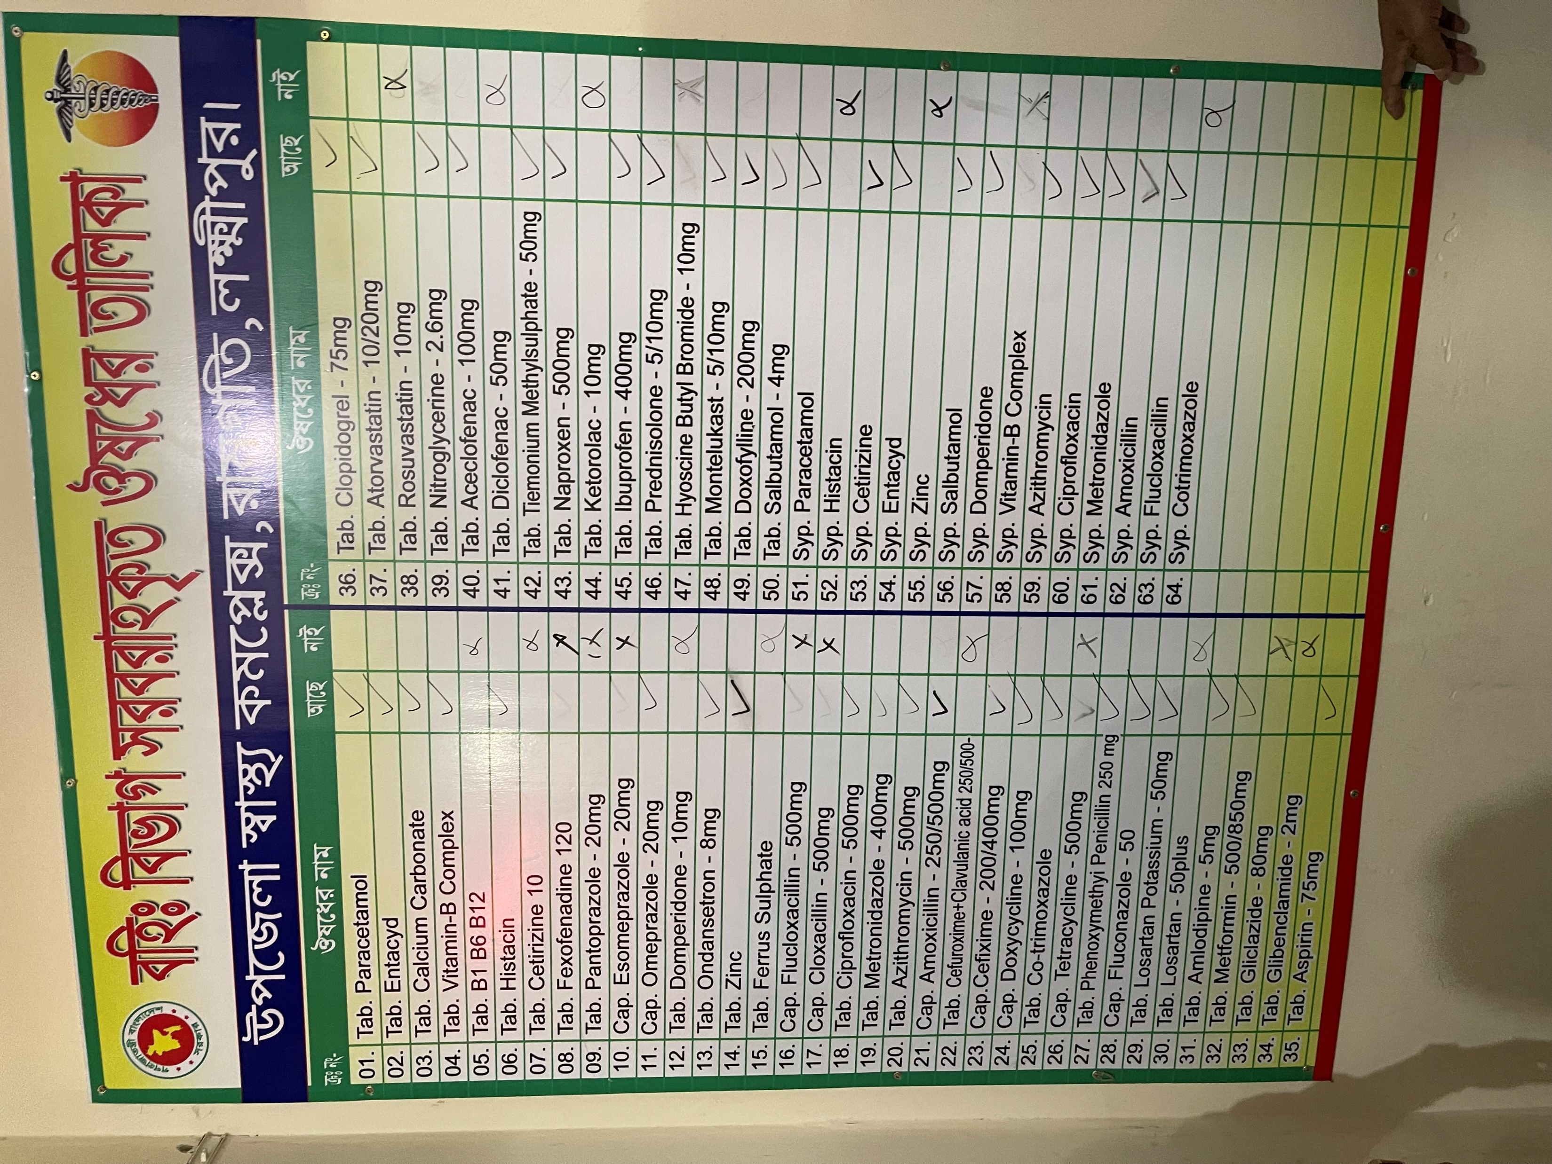
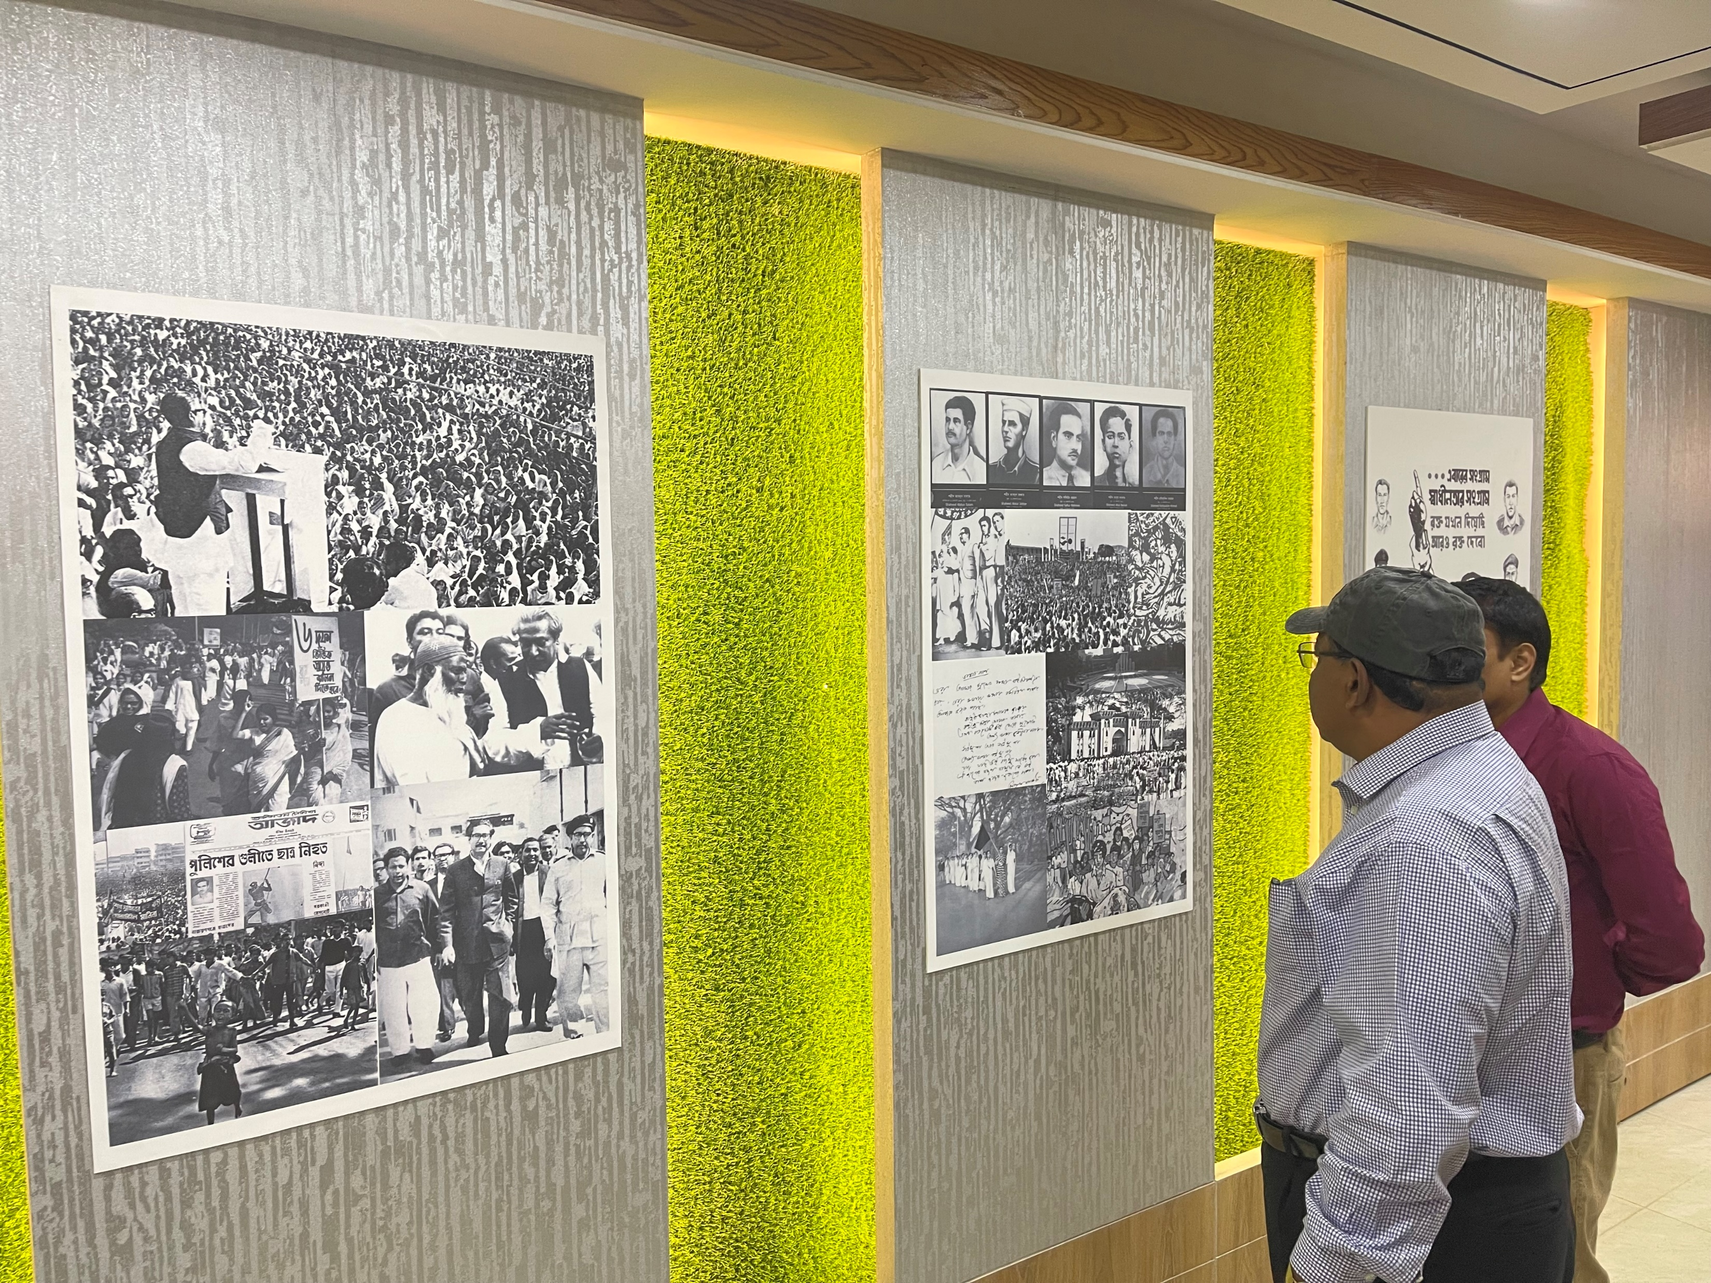
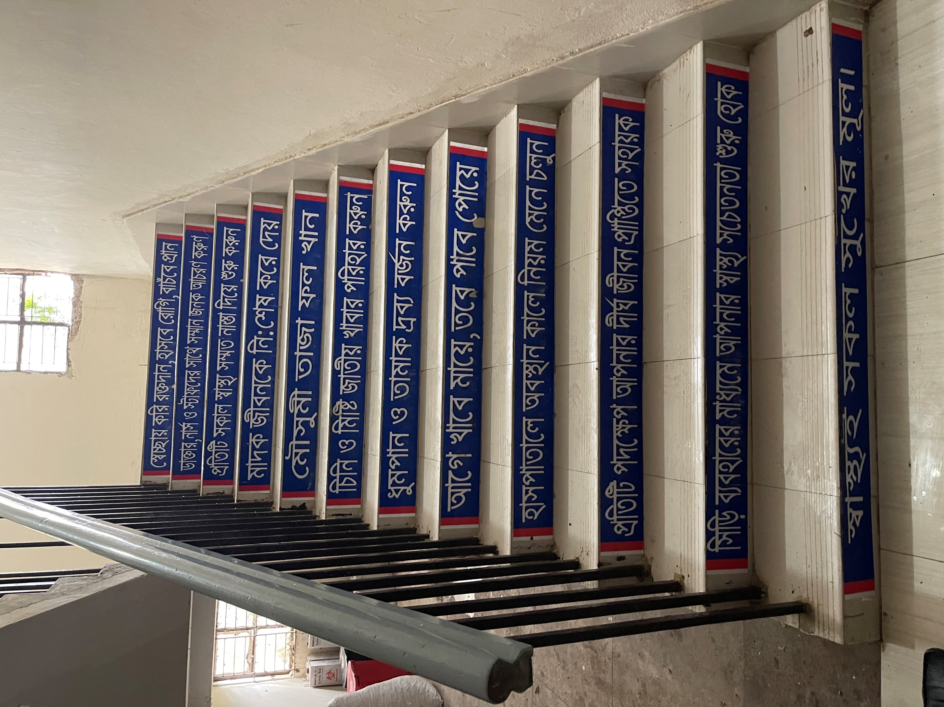
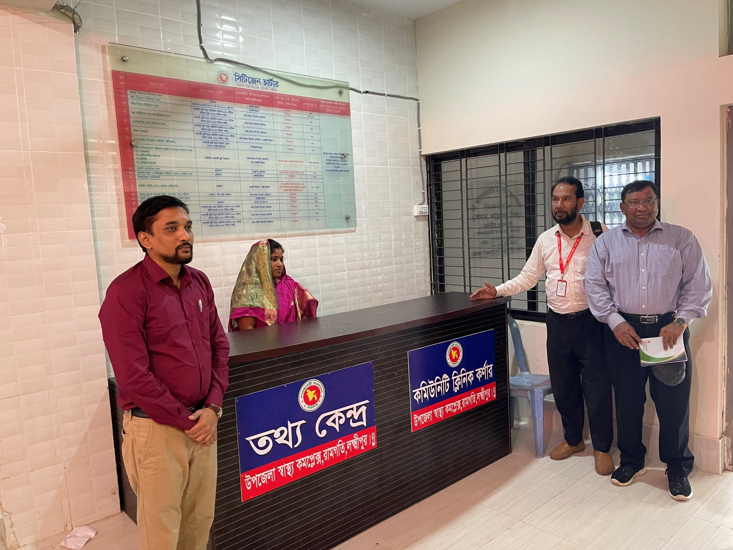
Innovation of Ramgati UHC
Please add date of each innovation
Liberation Corner
Supply Drug List
Health education messages on staircase
Information Desk

Slide 13
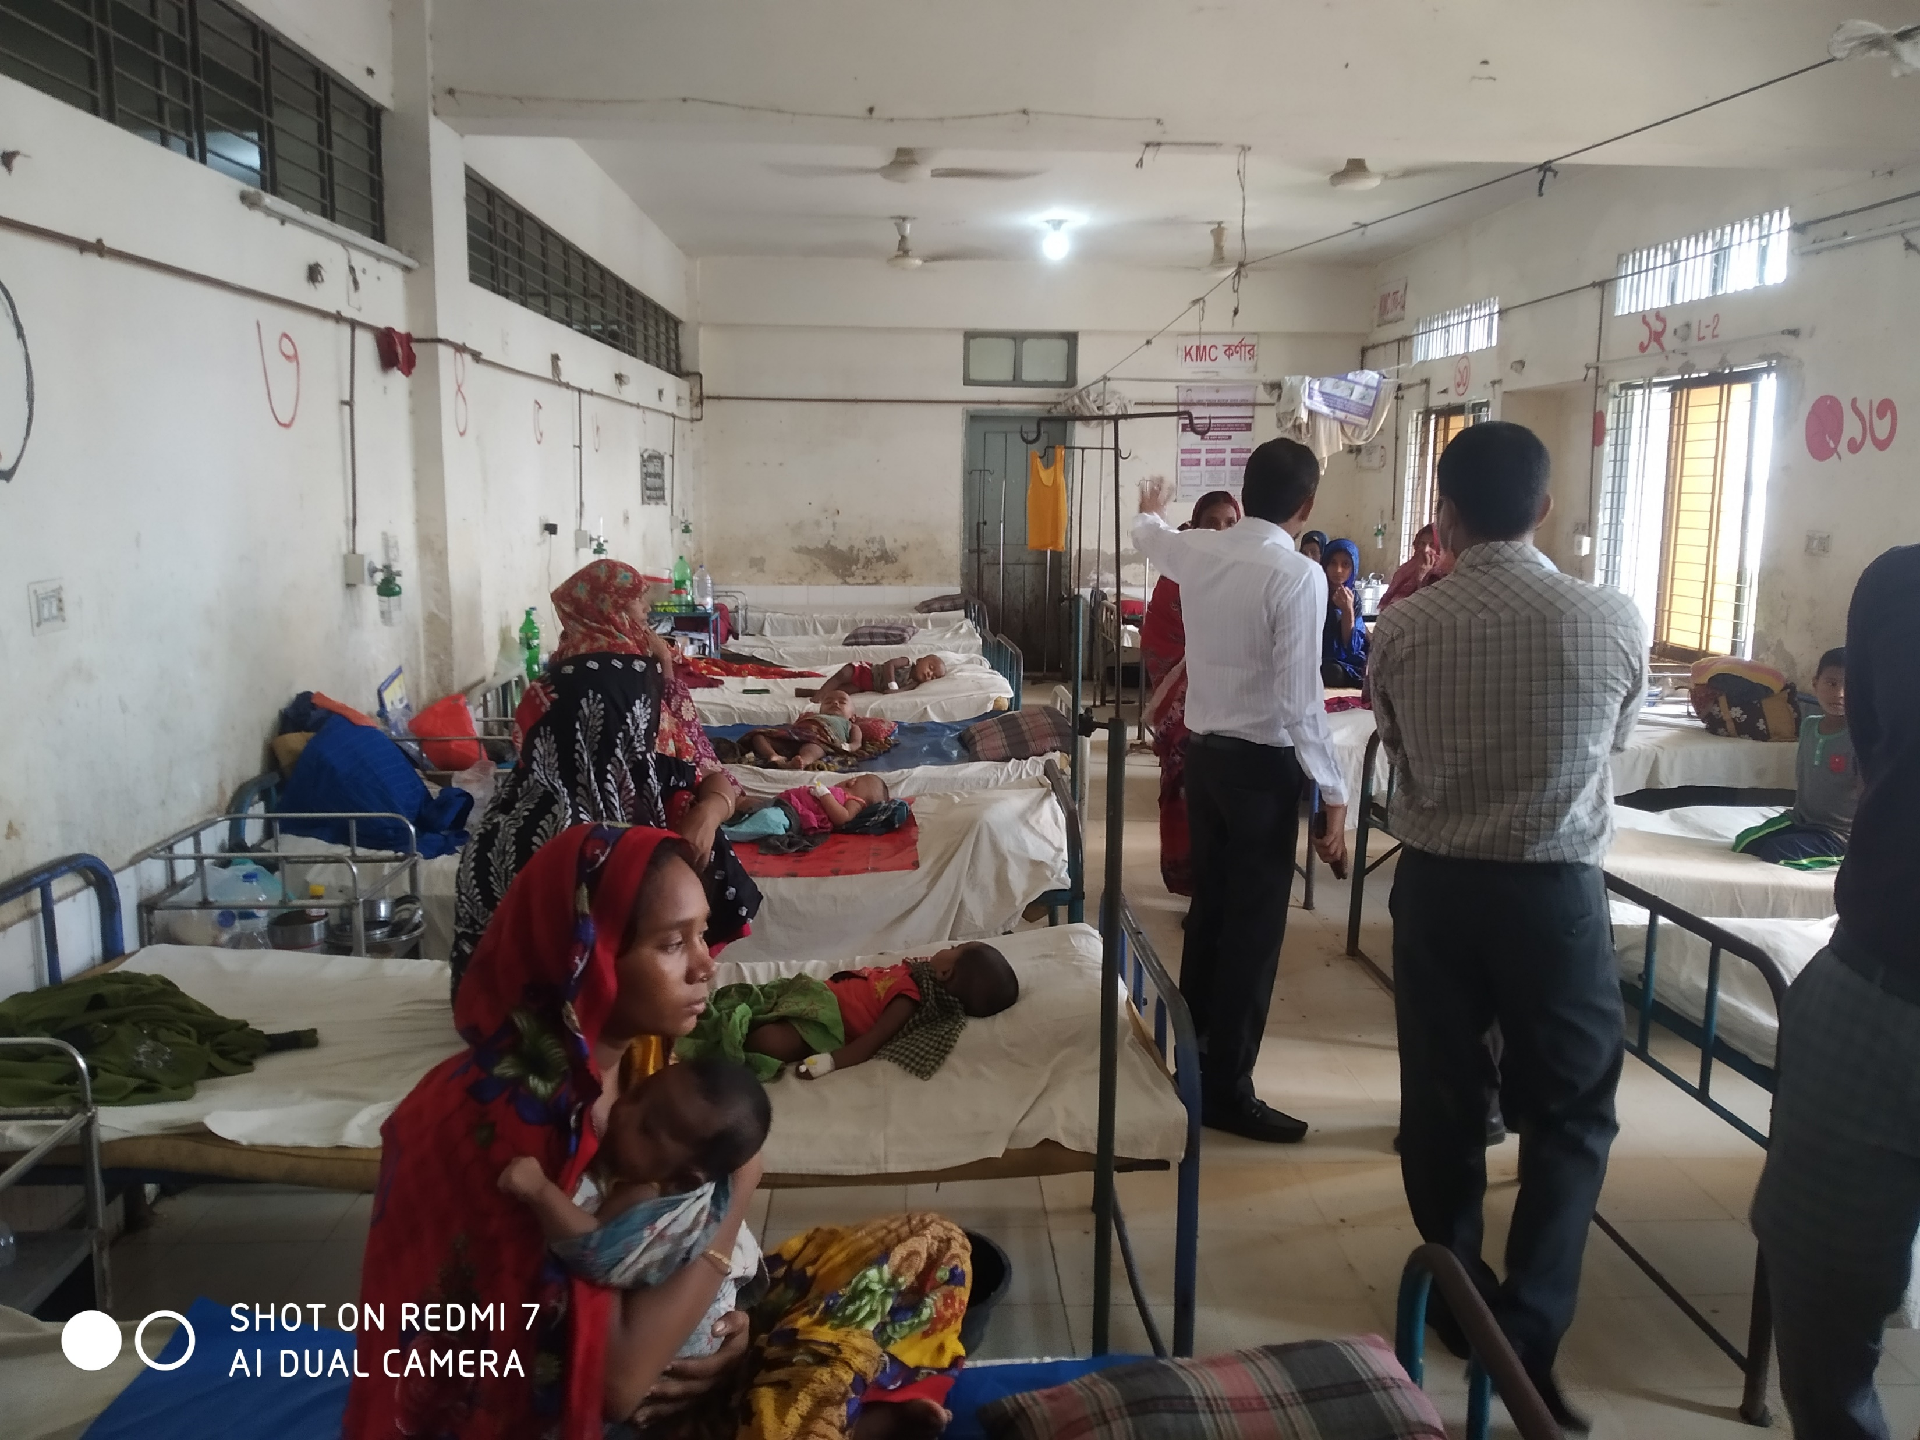
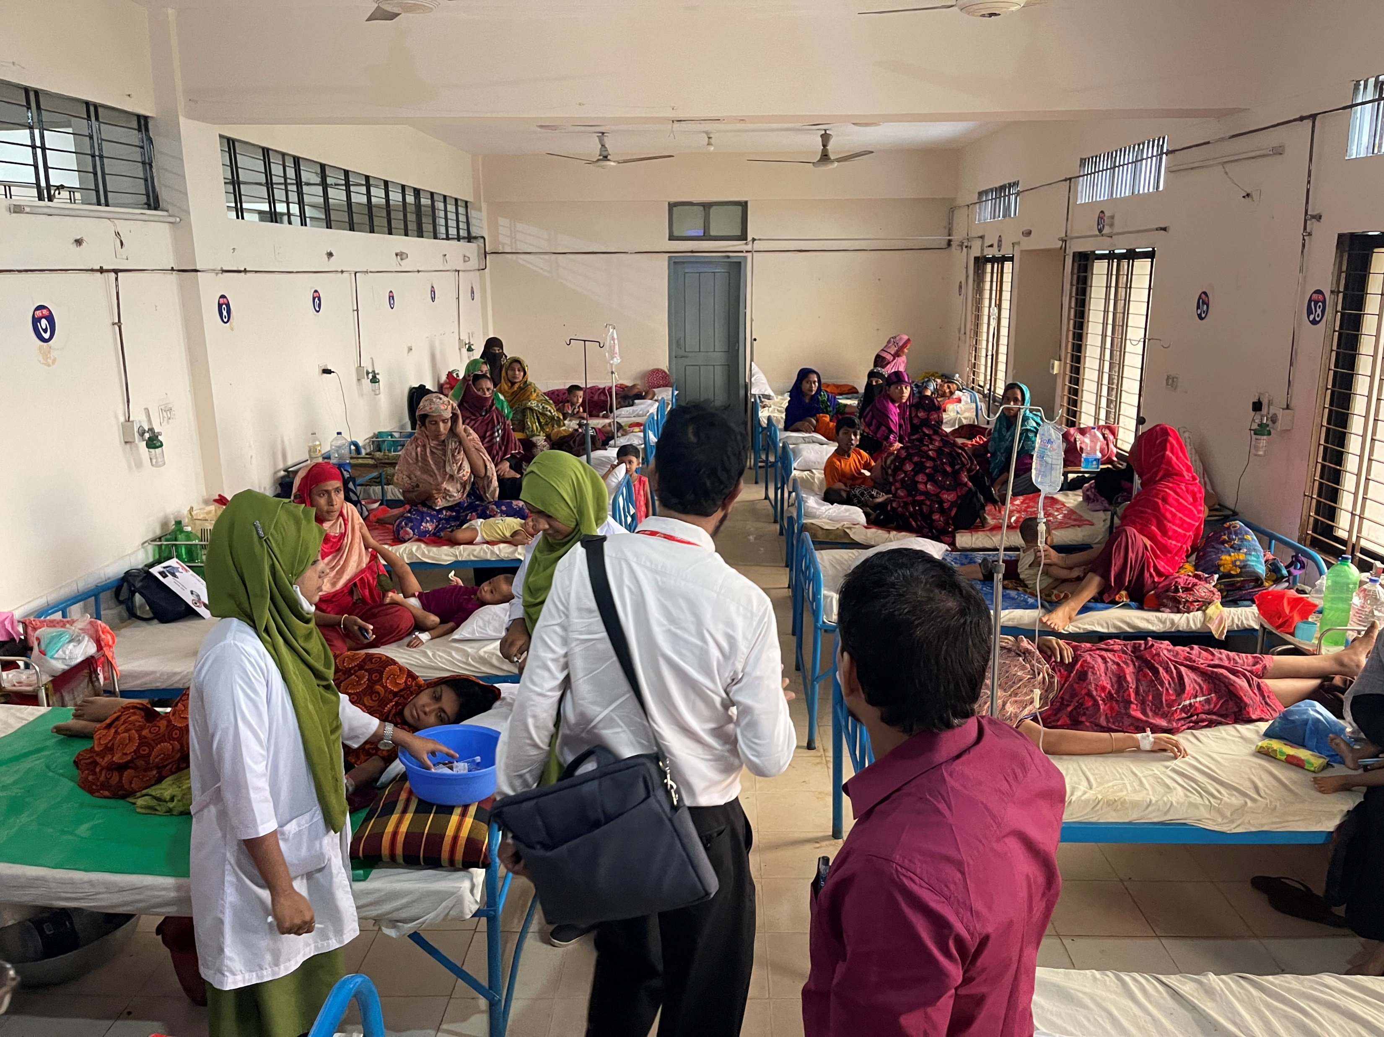
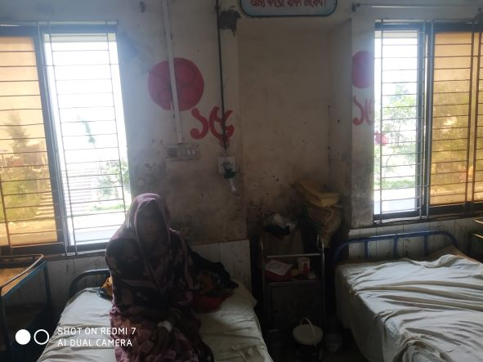
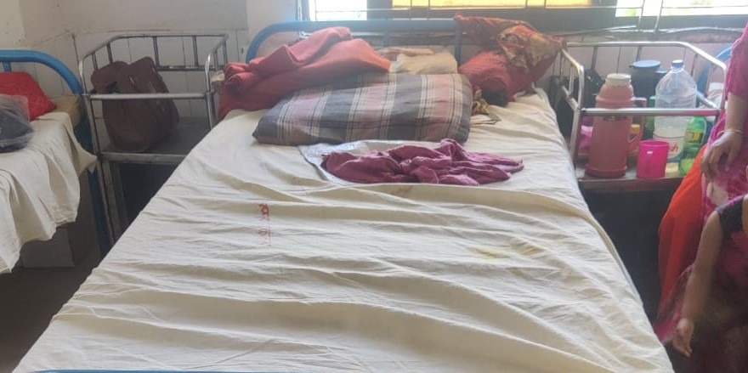
Changes in the Indoor
(Observational Difference between 1st August 22 and 13th September 22)
BEFORE
AFTER
BEFORE
AFTER

Slide 14
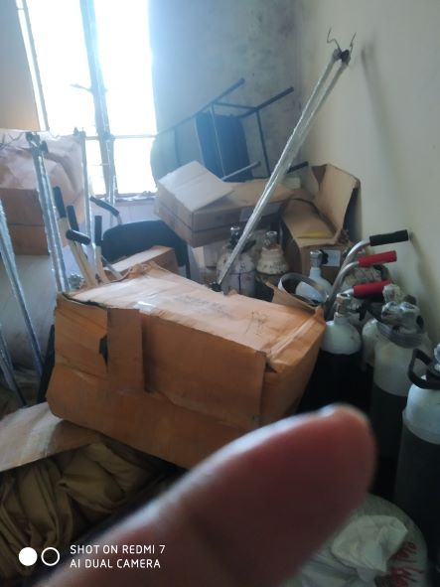
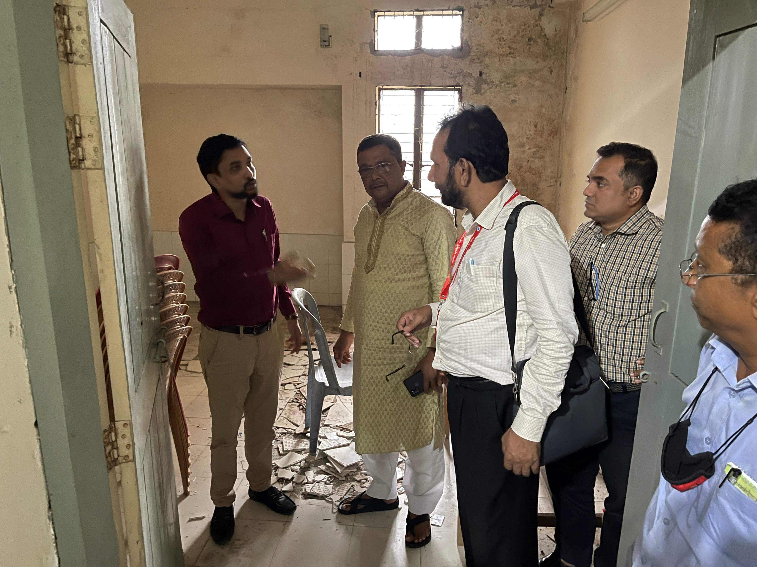
Removal of unwanted items for labour room
(Observational Difference between 1st August 22 and 13th September 22)
BEFORE
AFTER

Slide 15
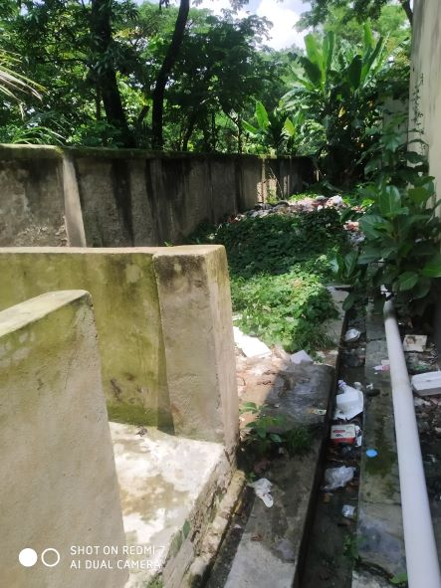
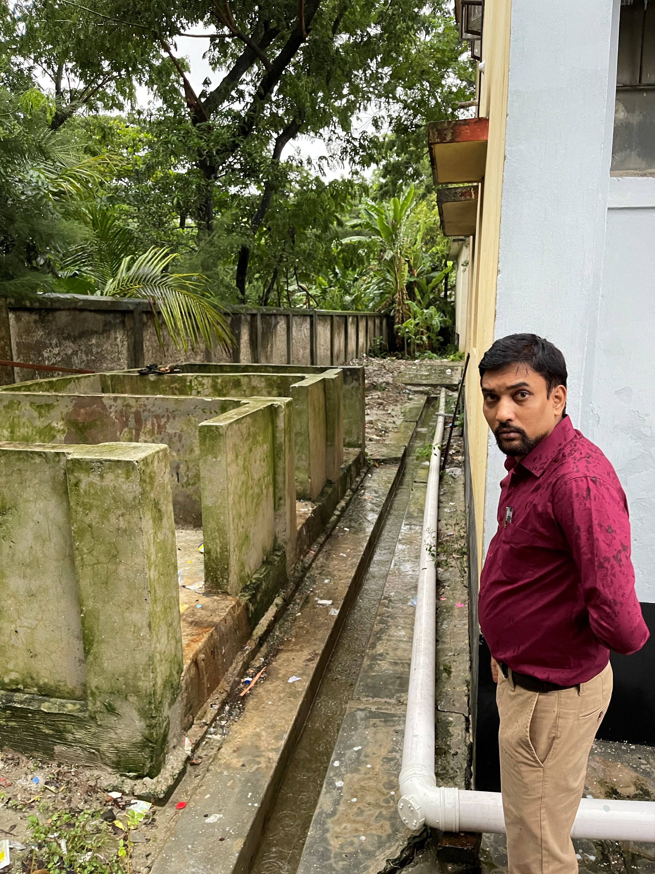
Improvement in waste management
(Observational Difference between 1st August 22 and 13th September 22)
BEFORE
AFTER

Slide 16
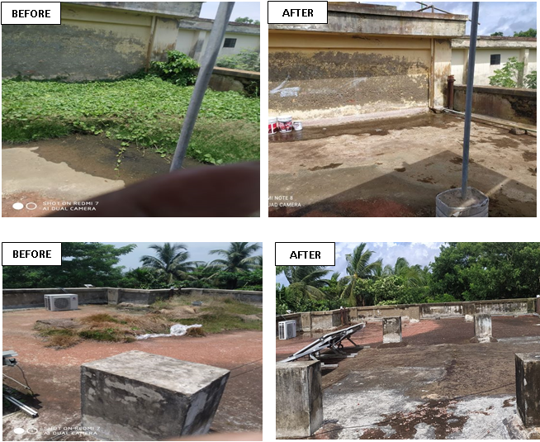
Changes on the Rooftop
(Observational Difference between 1st August 22 and 13th September 22)

Slide 17
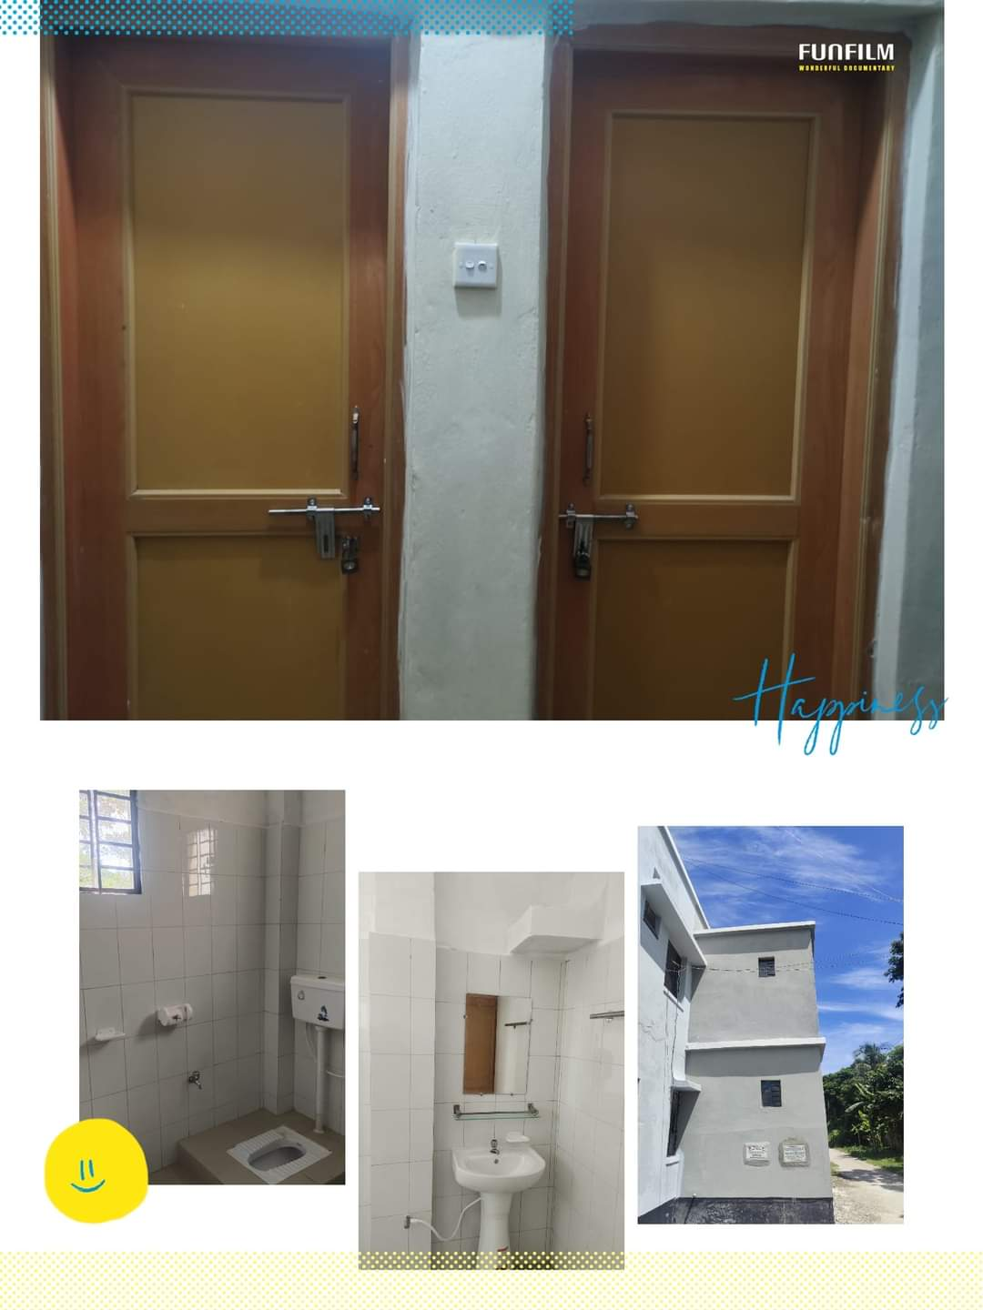
Newly constructed 4 washroom for patients
Functioning from September 2022

Slide 18
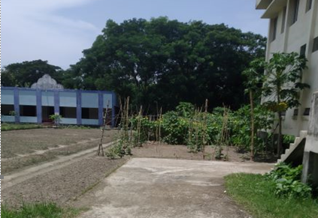
Vegetable Garden in UHC Campus

Slide 19
Community Support in Ramgati UHC
For Example:
One IPS & delivery instruments financed by JICA for 10 delivery centres in each union.
Central oxygen system financed and organized by Upazila Parishad.
Blood donated by about 100 enlisted blood donors in emergency need (Transfusion of 165 bag F/blood are given in 2021, 2022)
Fuel of Generator donated by MP and Upazilla Parishad .

Slide 20
Achievements of the UHC
For Example:
Strong support from Upazilla Parisad for renovation of the UHC.
A Jeep was allocated for UH&FPO by Govt.
Our corona vaccine coverage- 1st dose-86.25% and 2nd dose-81.3%
EPI coverage-99.99%
Establishment of effective dental unit.
Establishment of NCD corner.

Slide 21
Way Forward….
For Example:
Starting of VIA activities to prevent cervical and breast cancer of female.
Starting of C-section for delivery mother
Functioning of X-ray facility.
Establishment of USG service.
Functioning of ECG service.
Implementation of effective SSK program.
Establish a cycle stand close to the main gate.

Slide 22
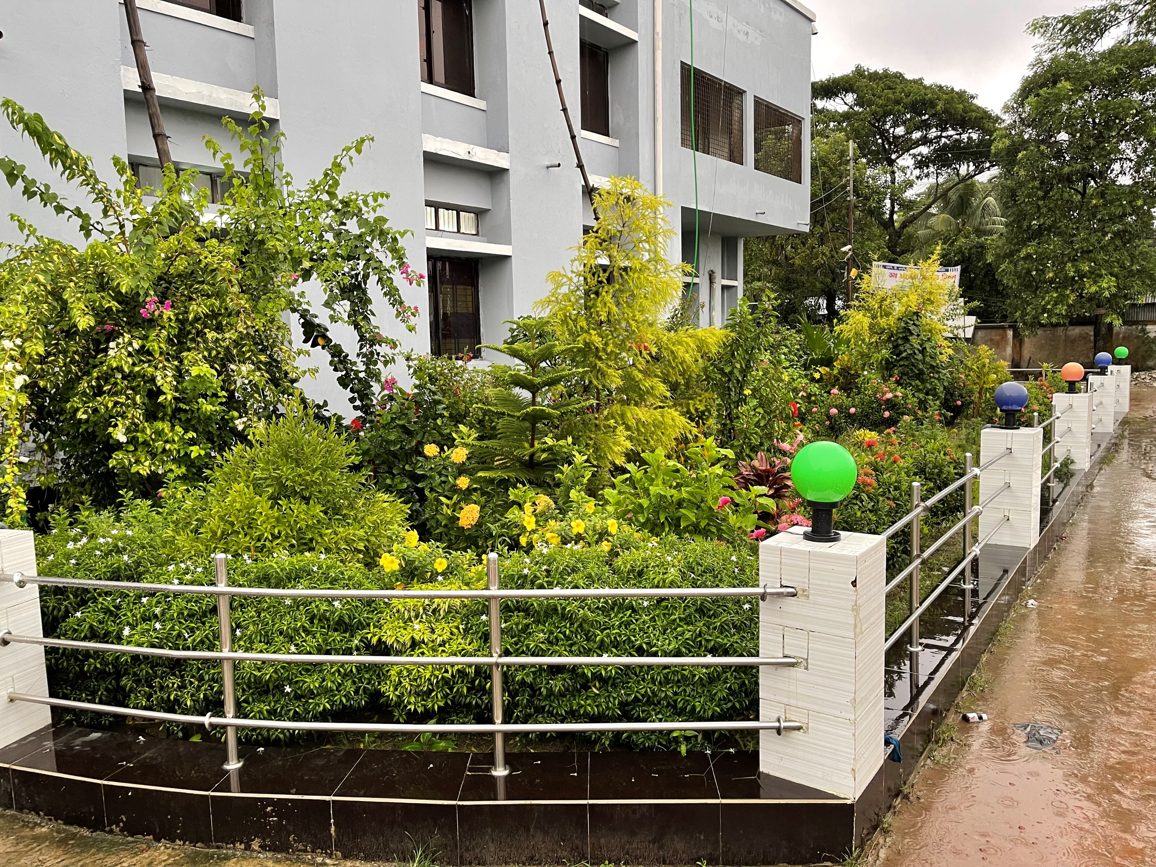
Hospital Garden
Thank You

